Slide 1
SASK LONG COVID PARTICIPANT PORTAL
Stakeholder - Dr. Osgood
CMPT 371 - Team 2 ID 4

Slide 2
Responsibilities
Roles | Responsible person
Project Manager | Jeet
Build Manager | Riley
Risk Officer | Hari
Dev Lead | Herve
Test Lead | Ini
Developers | Sasthi and Vaidehi
Testers | Chi and Vaidehi

Slide 3

Requirements set for this deliverable
Testing:
Write tests for existing code and future development.
Conduct smoke, unit, and integration testing.
Understand test hooks, assertions, and mocking.
Improve the test matrix and plan as we progress.
Development
Implement sign-in and registration with database and testing.
Add field constraints to sign-in/register pages.
Enable reading CSV files into the database and displaying in graphs.
Develop an admin interface to approve/reject and remove users.
Integrate logging frameworks.
Other tasks:
Use Git Issues for task delegation and issue tracking.
Create pull requests instead of merging on your own.
Conduct thorough testing of everything.
Notes:
Implement actual test cases for all code written so far and also write test cases for further development.
Implement smoke testing, unit and integration testing, and work on understanding test hooks, assertions and mocking.
Improve test matrix and update the test plan as we move forward.

Slide 4

Task Delegation
Moved task delegation from Asana to Git Issues due to learning challenges.
Git Issues provides better notification for assigned tasks and issue tracking. Link to team's Git Issues and tasks provided.
Assigned specific tasks with clear descriptions and expected outcomes.
Notify the project manager when tasks are completed and record actual completion time.
Use tags to categorize tasks based on their areas and priorities.
Notes:
Moved task delegation from Asana to Git Issues due to learning challenges.
Inconsistent usage and unclear subtask display led to the transition.
Actual vs. estimated time presentation was confusing for the team and instructors.
Git Issues provides better notification for assigned tasks and issue tracking.
Link to team's Git Issues and tasks provided.

Slide 5
Retrospective Inspection
Team met for retrospective inspection after last deliverable.
Discussed key retrospective questions and noted major issues from previous deliverable.
Discovered several things were not done correctly and had to change approach.
No progress on written test cases.
Deliverable fell short of expectations and more implementation and testing was needed.
Planning is decent but task completion rate needed improvement.

Slide 6
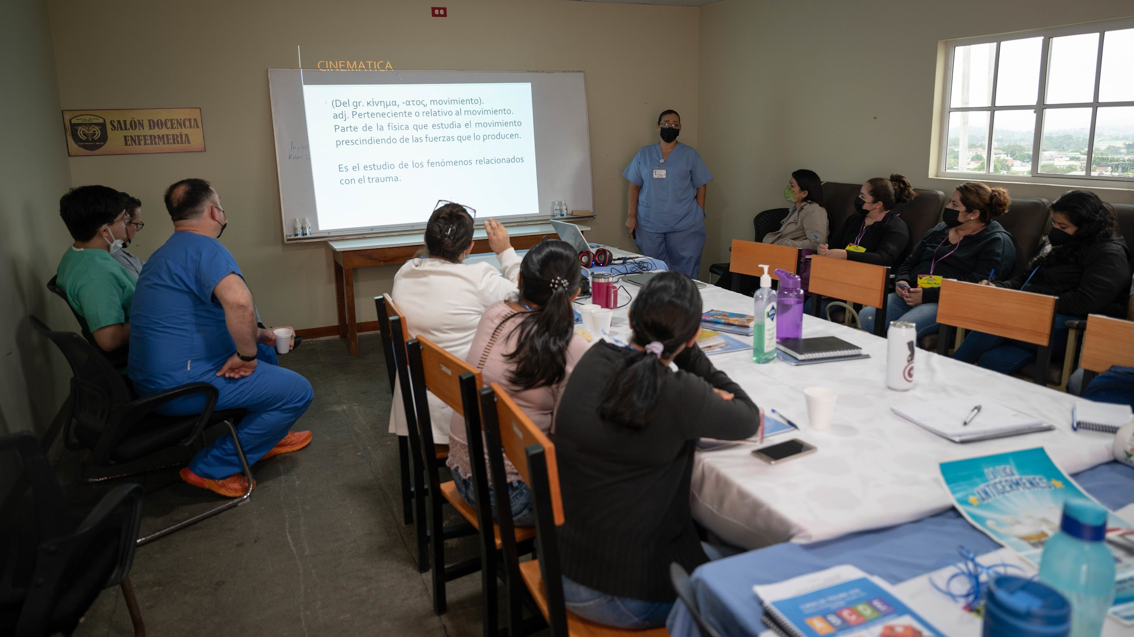
Tutorials and spreading knowledge
Pair programming sessions for testers & devs
Shared videos & articles for learning new technologies
Feedback for fixing issues
Discord channels for communication
Learning to write unit tests together
Knowledge sharing improved team understanding
Improved ability to complete tasks.

Slide 7
Issue tracking/defect reports
Utilized GitHub issues for tracking issues Implemented specific labels for bugs, priority, severity, and area
Established a clear resolution process for issues
Robust issue tracking system implemented for effective management
Clear labeling helps identify and prioritize issues
Efficient resolution process minimizes impact on development
Valuable as project progresses

Slide 8
Work on CI pipeline
Added smoke tests to Github Actions workflow
Enforced pull requests for merging changes
Strictly enforced branch naming conventions
Updated branch creation process
Improved code organization and debugging capabilities
Notes:
The team made several changes to improve their development process. Adding smoke tests to the GithubActions workflow ensures that critical parts of the application are functioning properly. Enforcing the use of pull requests and strict branch naming conventions helps keep the codebase organized and prevents issues caused by incorrect merges. These changes ensure that the development process is more efficient and effective, ultimately leading to a better end product.

Slide 9
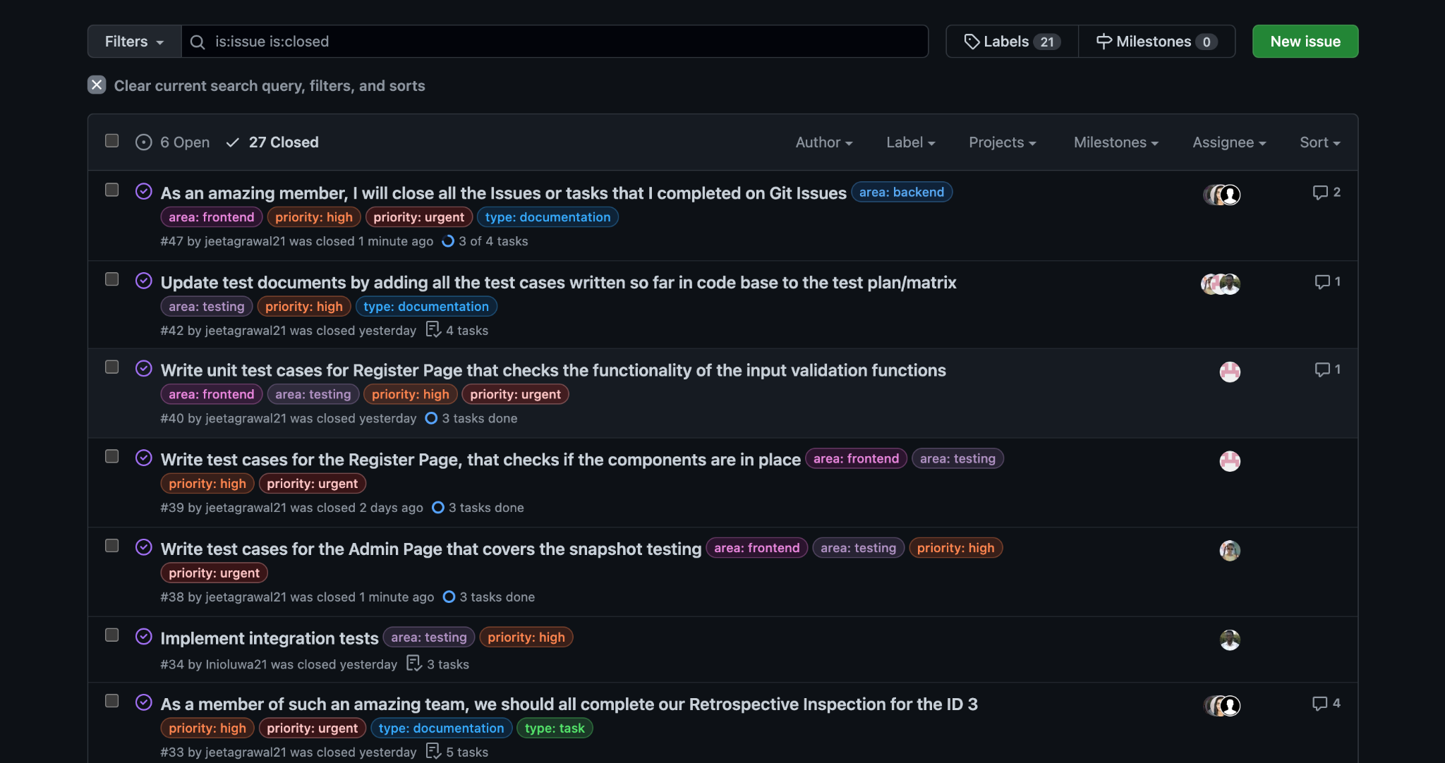
A view into our Git Issues

Slide 10
Time Tracking
We use a Google Sheet template to track the time we spend on the project.
This information helps us monitor project progress, identify bottlenecks, and track team productivity.
We use actual time to compare with our estimated time and plan to create a burndown chart for the project.
Actual and estimated times are recorded in Git Issues for user stories and tasks.

Slide 11
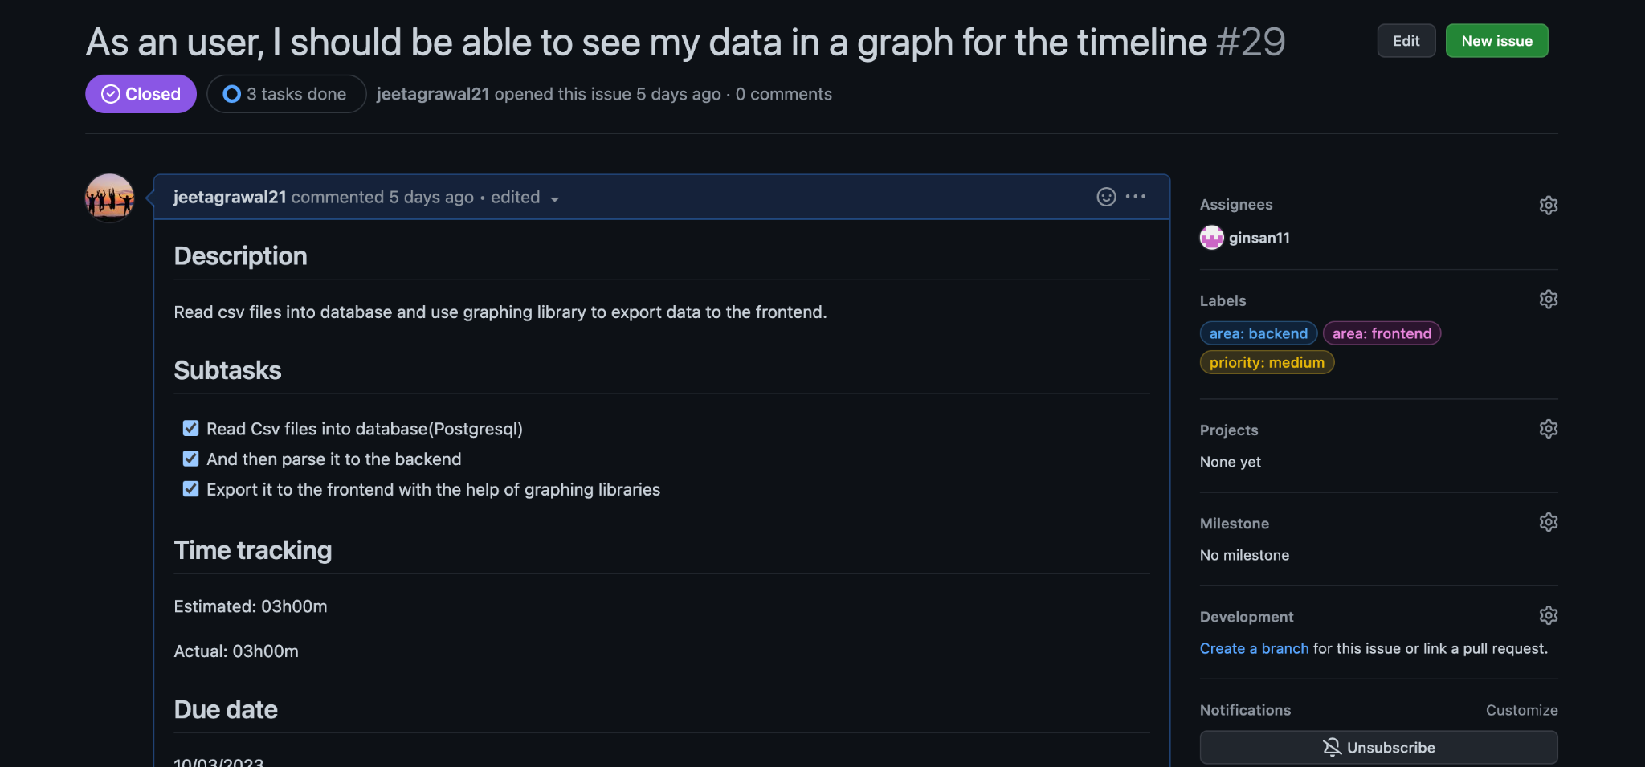
A view into our Git Issues

Slide 12
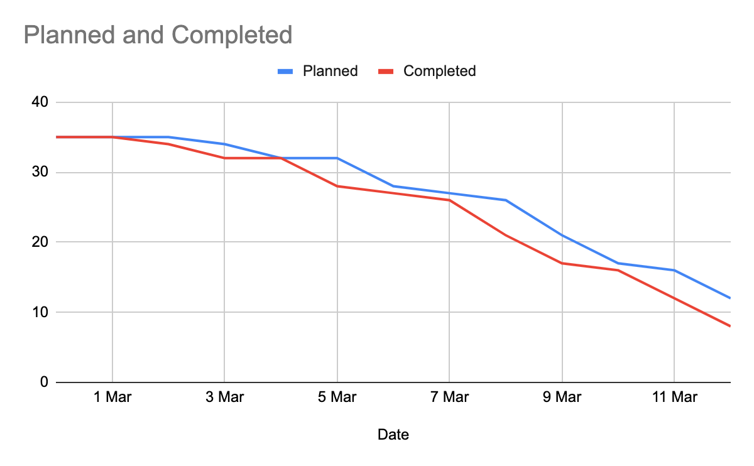
Burn Down Chart

Slide 13
Changes Implemented
Changes in architecture and technologies for the system
Addition of react-testing-library for testing
Moved to Git Issues for task delegation and issue tracking
Pair programming used for handling api calls, user input verification and testing
Developers contributed unit testing for all components and functions
Logging was implemented in both frontend and backend using loglevel library in the frontend and jet-logger library in the backend.
Notes:
The team made several changes to improve their development process. Adding smoke tests to the GithubActions workflow ensures that critical parts of the application are functioning properly. Enforcing the use of pull requests and strict branch naming conventions helps keep the codebase organized and prevents issues caused by incorrect merges. These changes ensure that the development process is more efficient and effective, ultimately leading to a better end product.

Slide 14
Current State of the system(Testing)
Unit and UI testing done on individual components using react testing library and Jest
TDD started for components with some test cases not passing yet due to unimplemented features
Integration testing performed on tasks using multiple components
Smoke tests implemented and placed in pipeline
Integration and system testing started on signin feature using selenium
Test plan in place for different types of testing and investment in testability
Notes:
After signing in from the home page, the user will be directed to the dashboard.
When the Register Now button is clicked, it leads to the registration page, which is currently a dead end as we do not yet have clarification on if we would be handling registration from our end and have someone authenticate it, or if someone (outside our system) does the registration for every participant and gives them their registration details.

Slide 15
Current State of the system(Development)
FRONTEND:
Login and Register page with requirements, error handling and redirection implemented
Signin and register page fields constraints implemented
Graph components created to display user data
Rigorous testing performed for all pages
Graph view for cough severity added
Notes:
After signing in from the home page, the user will be directed to the dashboard.
When the Register Now button is clicked, it leads to the registration page, which is currently a dead end as we do not yet have clarification on if we would be handling registration from our end and have someone authenticate it, or if someone (outside our system) does the registration for every participant and gives them their registration details.

Slide 16
Current State of the system(Development)
BACKEND:
System calls are established and operational
Login system is implemented and functioning correctly
Data fetching mechanism is functional for graph visualization
Rigorous testing conducted for login and data fetching functionalities
Emphasis on testing functions and rectifying errors Implementation of Excel user data formatting, storage, and presentation completed.
Notes:
After signing in from the home page, the user will be directed to the dashboard.
When the Register Now button is clicked, it leads to the registration page, which is currently a dead end as we do not yet have clarification on if we would be handling registration from our end and have someone authenticate it, or if someone (outside our system) does the registration for every participant and gives them their registration details.

Slide 17
Current State of the system(Development)
DATABASE:
Added API call to store frontend logs in the database for better user behavior tracking and analysis.
Improved efficiency and ease of use of database solution with pgadmin and documentation.
Notes:
After signing in from the home page, the user will be directed to the dashboard.
When the Register Now button is clicked, it leads to the registration page, which is currently a dead end as we do not yet have clarification on if we would be handling registration from our end and have someone authenticate it, or if someone (outside our system) does the registration for every participant and gives them their registration details.

Slide 18
Logging
Frontend Logging
Used loglevel library and its remote plugin to enable logging in the frontend
Encouraged team members to write clear and descriptive logs with relevant context
Provides a centralized view of system behavior and helps detect issues early on
Backend Logging:
Implemented jet-logger logging library in the backend, configured to output logs to console
Yet to implement saving logs to the database for long-term storage and analysis

Slide 19
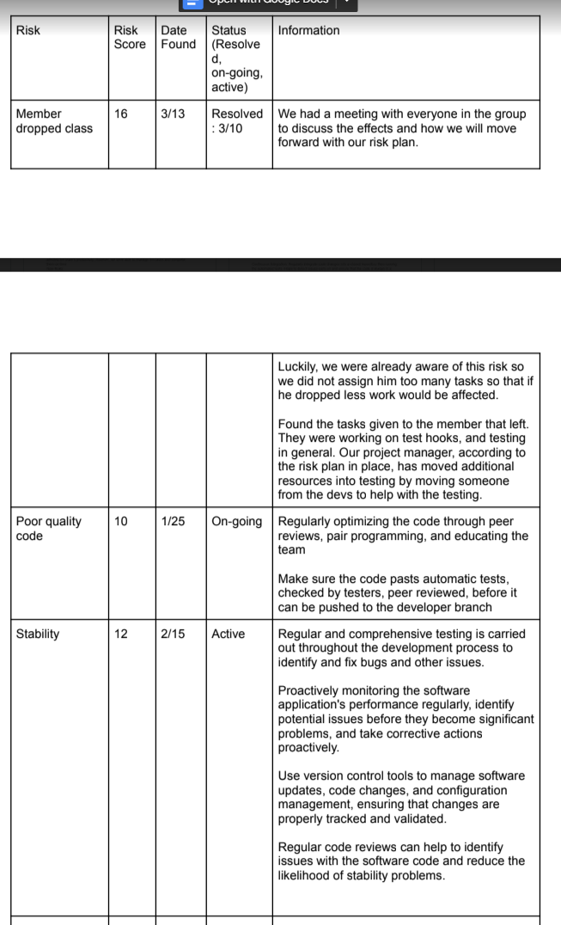
Risk
Risks we are tracking
Has risk score, date found, status and date of resolution, and information on what we have for it so far
Discuss risks during meetings, Risk Manager follows up

Slide 20
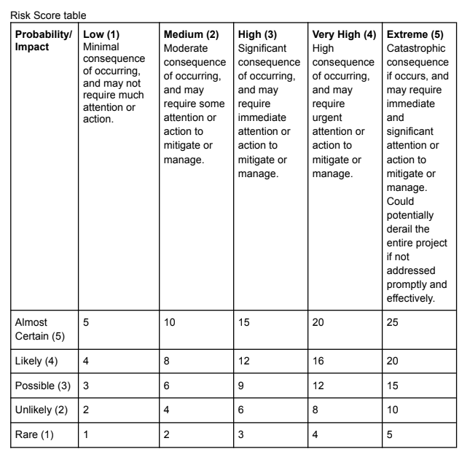
Risk
Risk Score Table

Slide 21
Risk Report
Ongoing Risks:
Poor Quality Code: The code may not meet the desired quality standards, leading to code re-work and delay in project delivery.
Security of Data: Sensitive data may be compromised due to lack of proper security measures, leading to potential legal and financial liabilities.
Poor Planning: Inadequate planning and scheduling may lead to project delays and increased costs.
Busy Schedules: The team members have other commitments, leading to difficulties in meeting project deadlines.
Communication: Poor communication among team members could lead to misunderstandings, errors, and delays in project delivery.

Slide 22
Risk Report
Resolved Risks:
Member Dropping the Class: One of our team members decided to drop the class, which affected the team's productivity. However, we were able to reassign the tasks and complete them on time.
New Risks:
Inexperience with Technology: Some team members may not have the required expertise with the software development tools and platforms, which could lead to technical difficulties and delays in project delivery.
Bugs not being fixed soon enough: Inadequate testing and debugging may lead to bugs in the code, which could affect the project's functionality and quality.

Slide 23
Meetings
With stakeholder:
Feedback on previous deliverable and discussing future features and data focus.
With entire team:
Weekly meetings for updates, task assignments, and availability.
Held in person or hybrid via Discord. Daily check-ins conducted by PM through Discord chats and video calls.
Troubleshooting:
Includes dealing with merge conflicts, debugging, error tracking, and issue fixing.
Troubleshooting done via Zoom or Discord, using Google and ChatGPT.

Slide 24
Reviews and Inspections
Retrospective Inspection and Reviews
The team discussed what we could have done better in the tutorial times.
Main issues that we improved upon:
Understanding technologies better since the steep learning curve slowed down our progress
One of our main developers dropped the class which taught us not to be dependent on one individual
Over estimation of goals due to incomplete understanding of the Template used for frontend

Slide 25
Peer Reviews
Artifacts reviewed: sign in page, register page, admin page, and navigation bar tests
Each person presented their work and received feedback from other team members .
Feedback included comments, critiques, and suggestions for improvement
Reviews helped team members learn from each other's work and identify areas for growth
Peer reviews will inform refactoring and implementation strategy

Slide 26
Plan for next deliverable
Finish up user login only after admin approval functionality
Add logout feature Display user data with more graphs and tables
Allow users to change agenda preferences
Show user login/logout timestamps in admin interface

Slide 27
Plan for next deliverable
Implement admin interface with ability to accept/reject or remove users
Export data with various constraints
Save user preferences to database via API calls
Hash all data for privacy and security

Slide 28
Plan for next deliverable
Testing:
Write more integration testing
Structure test files for easier debugging Expand testing with test hooks Implement coverage testing Integrate security into the system Conduct system testing.

Slide 29
Questions?

